Slide 1

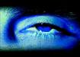
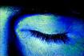
Drowsiness Detection using Opencv
KCS-752 Mini Project/Internship Assessment
Presented By- Sunny Yadav
Section- CSE- A
Roll No- 1803210154
Year- 4th Year
Semester- 7 Sem
Submitted to- Mrs. Aditi Arora

Slide 2
Outlines
Objective
Motivation
Requirement
Idea
Algorithms
Flow Diagram
Working
Conclusion
References

Slide 3
Introduction
Our aim is to provide a driver drowsiness system which will alert not only the driver but also the co-passengers with a loud alarm in the car. By using face tracking and video processing.
The system works in spite of driver wearing spectacles and in various lighting conditions.

Slide 4
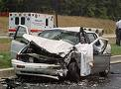
Motivation
A study (In the U.S) showed that 37% of drivers surveyed admitted to falling asleep at the wheel.
An estimated 1.35 million drivers have been involved in a drowsy driving related crash in the past five years.
Fall-asleep crashes are likely to be serious. The morbidity and mortality associated with drowsy-driving crashes are high, perhaps because of the higher speeds involved (Horne, Reyner, 1995b) combined with delayed reaction time.

Slide 5
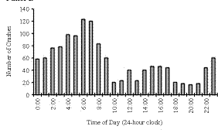
Accidents study in the U.S (1990-92):
Time of occurrence of crashes in drivers at ages 26 to 45 in which the crashes were attributed by the police to the driver being asleep (but in which alcohol was not judged to be involved).
The X axis is the time of day and the Y axis is the number of crashes.

Slide 6
Requirement
Hardware Requirements:-
Camera
Laptop (intel i3 ,4gb RAM)
Software Requirements:-
Pycharm
Python
opencv

Slide 7
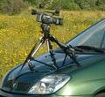
Idea
A video camera placed inside the car is continuously filming the driver’s face during the ride.
A detection system analyses the movie frame by frame and determines whether the driver’s eyes are open or shut.
If the eyes are shut for more than 1/4 a second (longer than a normal blink period) then the systems beeps to alert the driver.

Slide 8
Algorithms
Haar Cascade Algorithm
Eye Aspect Ratio [EAR]
Lips Aspect Ratio [LAR]

Slide 9
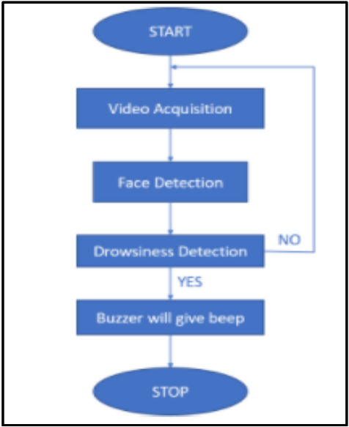
Flow Diagram

Slide 10
Working
Drivers face is continuously monitored using a video camera.
In order to detect the drowsiness the first step is to detect the face using the series of frame shots taken by the camera.
Then the location of the eyes and lips is detected
If eye is closed more than a specific time or number of yawn is more than specific number than alert signal generated.
If the signal crosses the threshold, then the alarm produce loud sound and the driver can wake up by that.

Slide 11
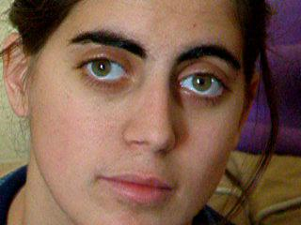
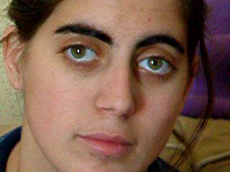
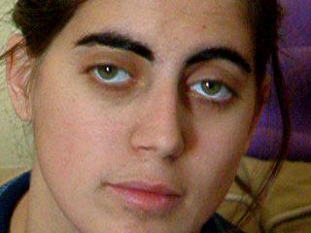
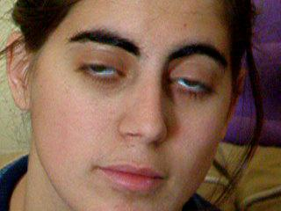
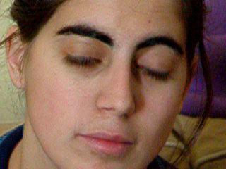
30 frames
per second

Slide 12
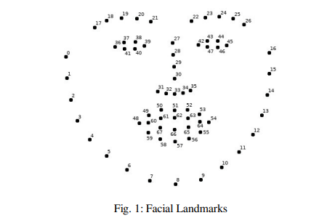
dlib library is used for detecting faces and Yawn
facial landmarks of a person is shown in figure

Slide 13
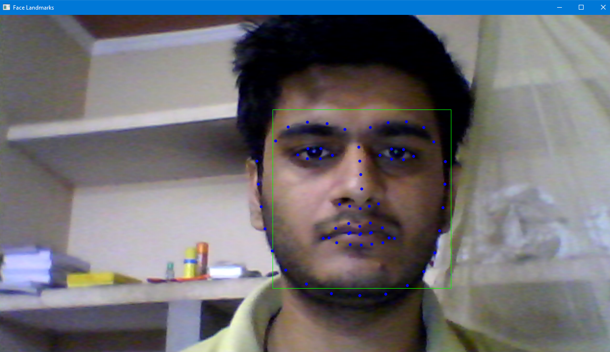

Slide 14
EAR algorithm:
Step 1: Use the Detected Eye region from the EAR algorithm
Step 2: Compute the Eye Aspect Ratio to determine if the eyes are closed
Step 3: If EAR satisfies the drowsy condition then move to step 5
Step 4: If EAR is normal then go to Step 1
Step 5: Sound Alarm

Slide 15
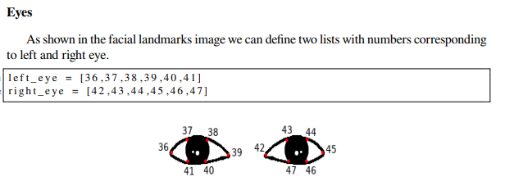

Slide 16
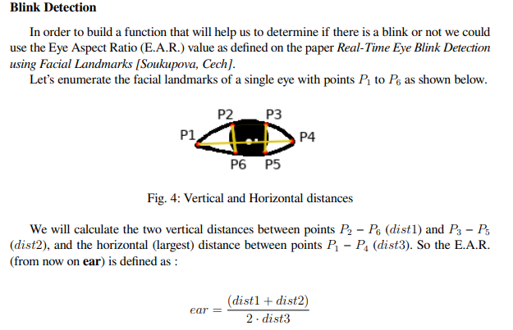

Slide 17
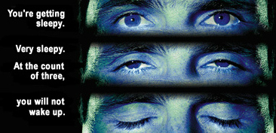

Slide 18
LAR Algorithm:
Step 1: Use the Detected lips region from the LAR algorithm
Step 2: Compute the Lips Aspect Ratio to determine if the Lips are closed or open
Step 3: If LAR satisfies the drowsy condition then move to step 5
Step 4: If LAR is normal then go to Step 1
Step 5: Sound Alarm

Slide 19
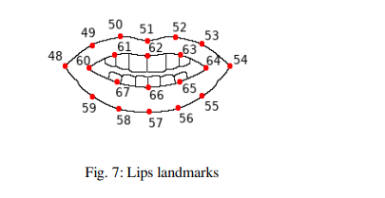
Lips
To find out if there is a yawn or not we will work exactly as before on the eyes section. First let’s define a list with numbers corresponding to the lips part of a face as shown in the facial landmarks image.
l i p s = [ 6 0 , 6 1 , 6 2 , 6 3 , 6 4 , 6 5 , 6 6 , 6 7 ] # Landmark i n d e x e s

Slide 20
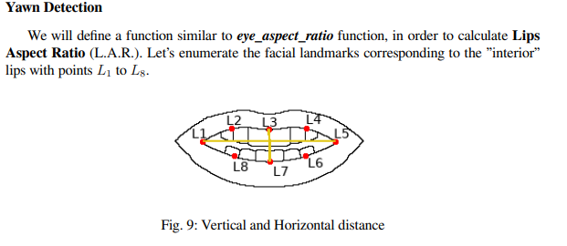

Slide 21
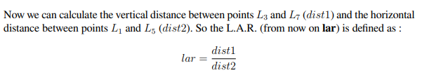
LAR threshold value to 0.5

Slide 22
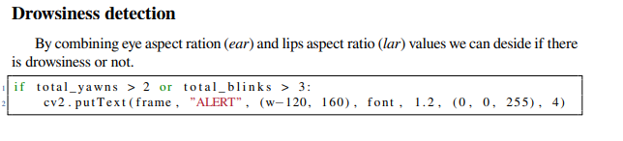
EAR =Eye Aspect ratio EAR threshold=0.3
LAR= Lips Aspect Ratio LAR threshold =0.5

Slide 23
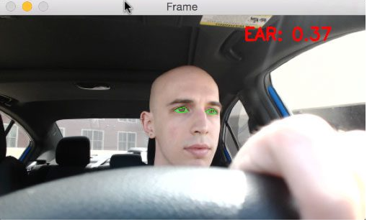
Calculating EAR (to check whether Eye is open or not)

Slide 24
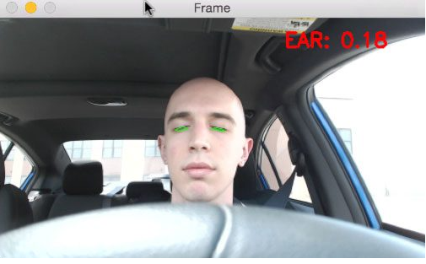
Decrease in Eye Aspect Ratio when Eye is closed

Slide 25
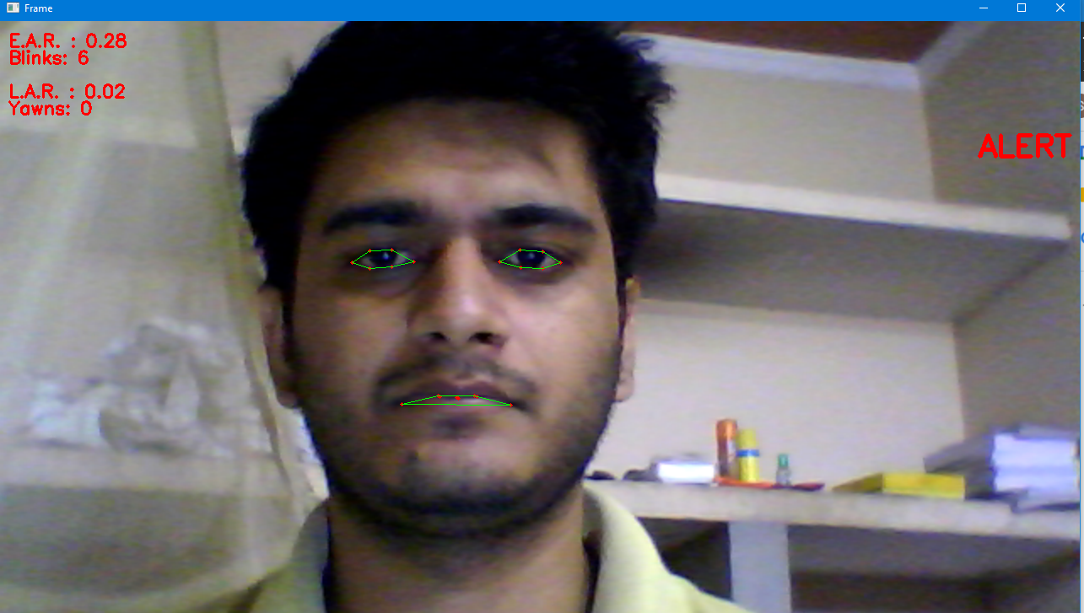

Slide 26
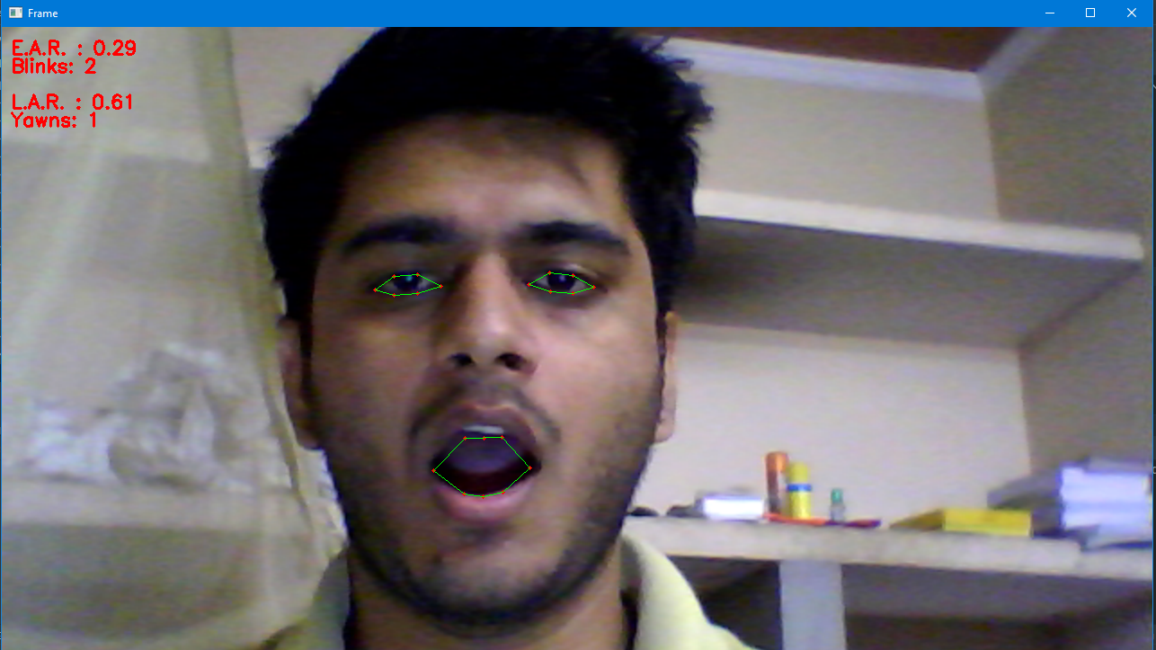

Slide 27
Conclusion
It has a wide scope in the future and can be improved to detect that in car driver is wearing a seat belt or mask.
The vehicle manufacturers can make this system inbuilt by using the dashboard screen and speakers.
The system can be effectively used in locomotives and flights for detecting driver drowsiness.
System can be improved to work with if driver is wearing spectacles.
In near future it can be associated with traffic police if person violate so many rules he/she can be punished.

Slide 28
Reference:
Aryan verma Youtube (https://www.youtube.com/watch?v=ksi42rwGyas&t=647s)
Drowsiness Detection with OpenCV (https://www.pyimag esearch.com/2017/05/08/drowsiness-detection-opencv/)
V B Navya Kiran, Raksha R, Anisoor Rahman, Varsha K N, Dr. Nagamani N P, 2020, Driver Drowsiness Detection, INTERNATIONAL JOURNAL OF ENGINEERING RESEARCH & TECHNOLOGY (IJERT) NCAIT – 2020 (Volume 8 – Issue 15)

Slide 29
Thank you
Thank you !!

